Slide 1
+
QuickDoc
ER Diagrams
Team 4 • CS691 • Pace University • Sprint 2 & Sprint 3
Conceptual ERD | Logical ERD | Sprint 2 + Sprint 3 Scope

Slide 2
Team 4 : QuickDoc
Conceptual ERD — List of Entities
Entity Name | Description | Primary Attributes
Patient | Represents a registered patient user | patientId (PK), firstName, lastName, dateOfBirth
Doctor | Represents a registered healthcare provider | doctorId (PK), firstName, lastName, licenseNumber
Specialty | Medical specialty assigned to a doctor | specialtyId (PK), name, description
Appointment | A booking between a patient and a doctor | appointmentId (PK), patientId, doctorId, dateTime
Review | A patient's review and rating for a doctor | reviewId (PK), patientId, doctorId, rating
Favorite | A patient's saved/favorite doctor | favoriteId (PK), patientId, doctorId, createdAt
Schedule | A doctor's available time slots for booking | scheduleId (PK), doctorId, dayOfWeek, startTime
Payment | Payment record linked to an appointment | paymentId (PK), appointmentId, amount, status
Prescription | Medication prescription issued by a doctor | prescriptionId (PK), doctorId, patientId, medication
MedicalRecord | Patient medical history and diagnosis records | recordId (PK), patientId, diagnosis, recordDate
Message | Secure message sent between patient and doctor | messageId (PK), senderId, receiverId, content
Notification | System notification sent to a user | notificationId (PK), userId, message, isRead

Slide 3
Team 4 : QuickDoc
Conceptual ER Diagram

Slide 4
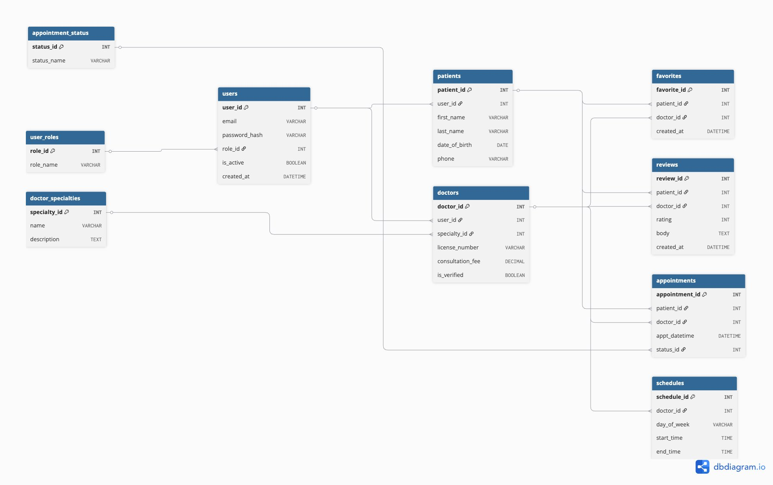
Team 4 : QuickDoc
Logical ER Diagram — Sprint 2 & Sprint 3 Scope
Reference Tables

